Slide 1
PROC GLIMMIX
Generalized Linear Mixed Models in SAS

Slide 2

Linear Model
$Y_{ij}|X_{ij}, =X_{ij}^{′}β+ε_{ij}$
$ε_{ij}\sim N\left(0,Σ\right)$
$Y_{ij}|X_{ij}, \sim N\left(X_{ij}^{′}β,Σ\right)$
Proc GLM, REG, etc.

Slide 3
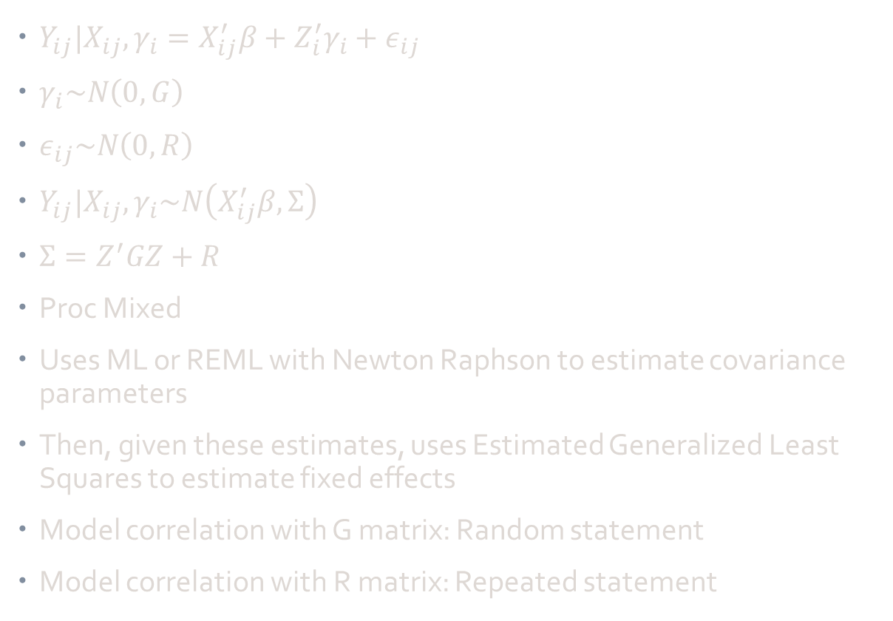
Linear Mixed Model
$Y_{ij}|X_{ij},γ_{i}=X_{ij}^{′}β+Z_{i}^{′}γ_{i}+ε_{ij}$
$γ_{i}\sim N\left(0,G\right)$
$ε_{ij}\sim N\left(0,R\right)$
$Y_{ij}|X_{ij},γ_{i}\sim N\left(X_{ij}^{′}β,Σ\right)$
$Σ=Z^{′}GZ+R$
Proc Mixed
Uses ML or REML with Newton Raphson to estimate covariance parameters
Then, given these estimates, uses Estimated Generalized Least Squares to estimate fixed effects
Model correlation with G matrix: Random statement
Model correlation with R matrix: Repeated statement

Slide 4

Generalized Linear Model
$g\left(E\left[Y_{ij}|X_{ij},γ_{i}\right]\right)=X_{ij}^{′}β$
g is link function
Specify some exponential family
Proc GENMOD (without REPEATED statement)
Uses ML with Newton Raphson to estimate regression parameters

Slide 5
Non-Normal Data With Correlation
Subject-specific (conditional) interpretation
Quadrature/Laplace (GLIMMIX or NLMIXED)
Subject-specific pseudo-likelihood (GLIMMIX)
Like a GLM with correlation in G matrix (random statement)
Population-averaged (marginal) interpretation
Generalized estimating equations (GENMOD)
Mean (pop-averaged) pseudo-likelihood (GLIMMIX)
Like a GLM with correlation in R matrix (repeated statement)

Slide 6
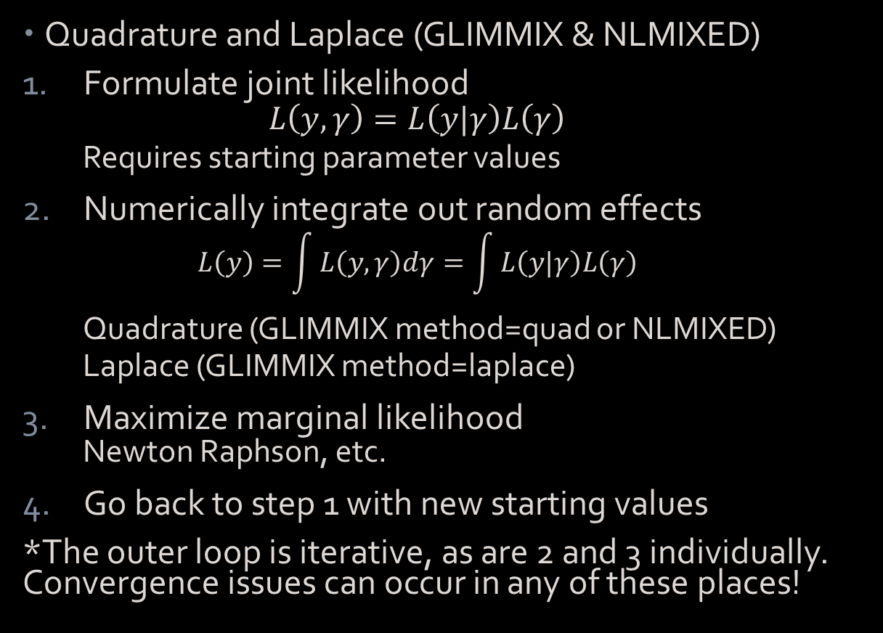
Subject-Specific Models
Quadrature and Laplace (GLIMMIX & NLMIXED)
Formulate joint likelihood
$$L\left(y,γ\right)=L\left(y|γ\right)L\left(γ\right)$$
Requires starting parameter values
Numerically integrate out random effects
$$L\left(y\right)=\int{L\left(y,γ\right)dγ}=\int{L\left(y|γ\right)L\left(γ\right)}$$
Quadrature (GLIMMIX method=quad or NLMIXED)
Laplace (GLIMMIX method=laplace)
Maximize marginal likelihood
Newton Raphson, etc.
Go back to step 1 with new starting values
*The outer loop is iterative, as are 2 and 3 individually. Convergence issues can occur in any of these places!

Slide 7
Subject-Specific Models
Subject-Specific Pseudo-Likelihood (GLIMMIX)
Generate pseudo data (normal dist)
Taylor approximation of data using starting values
Random effects included in locus of expansion
Call Proc MIXED
ML or REML with Newton Raphson to estimate covariance parameters
Estimated Generalized Least Squares to estimate fixed effects
Go back to step 1 with new starting values
GLIMMIX method=rspl like REML
GLIMMIX method=mspl like ML
*The outer loop is iterative, as is 2 individually. Convergence issues can occur in any of these places!

Slide 8
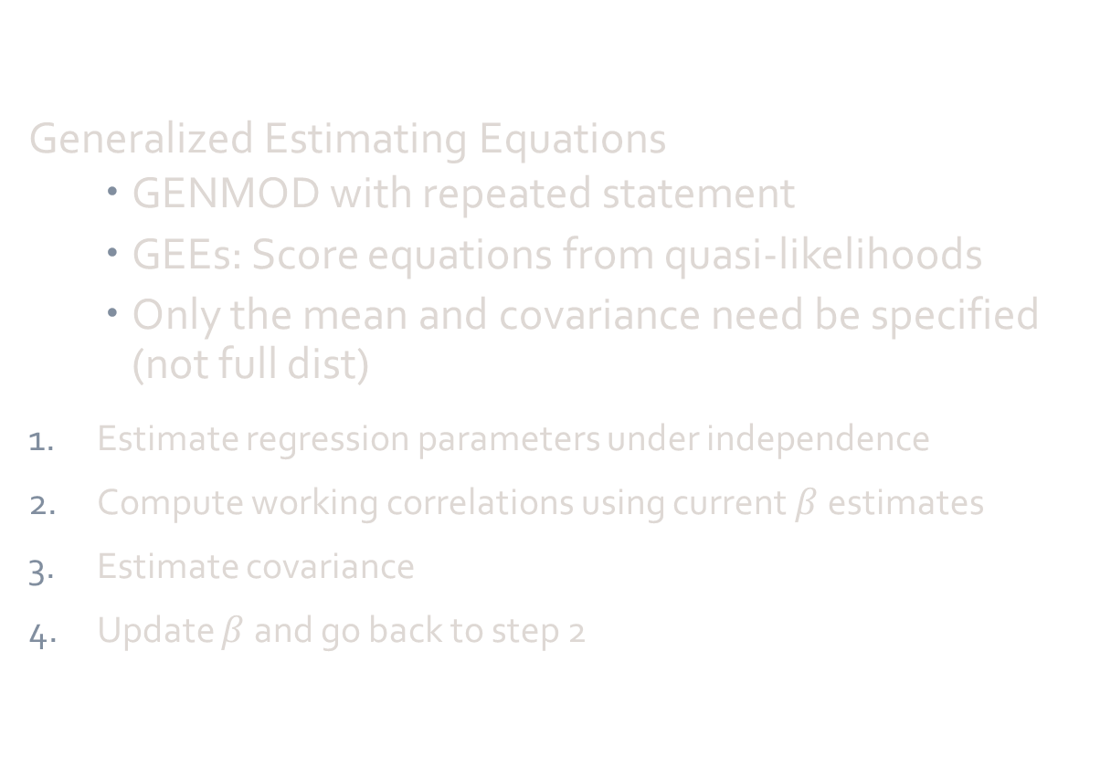
Population-Averaged Models
Generalized Estimating Equations
GENMOD with repeated statement
GEEs: Score equations from quasi-likelihoods
Only the mean and covariance need be specified (not full dist)
Estimate regression parameters under independence
Compute working correlations using current $β$estimates
Estimate covariance
Update $β$ and go back to step 2

Slide 9
Population-Averaged Models
Population-Averaged Pseudo-Likelihood (GLIMMIX)
Generate pseudo data (normal dist)
Taylor approximation of data using starting values
Random effects NOT included in locus of expansion
Call Proc MIXED
ML or REML with Newton Raphson to estimate covariance parameters
Estimated Generalized Least Squares to estimate fixed effects
Go back to step 1 with new starting values
GLIMMIX method=rmpl like REML
GLIMMIX method=mmpl like ML
*The outer loop is iterative, as is 2 individually. Convergence issues can occur in any of these places!

Slide 10
 | Linear | GLM | LMM (random) | LMM (repeated) | GLMM
 |  |  |  |  | Subj-Spec | Pop-Av
GLIMMIX | Dist=normal Link=identity No random statement | Dist=___ Link=___ No random statement | Dist=normal Link=identity Random statement |  | Dist=___ Link=___ Random statement Method=mspl,rspl,laplace,quad | Dist=___ Link=___ Random statement Method=mmpl,rmpl
Other Proc | REG, GLM, GENMOD, MIXED, etc. | GENMOD, LOGISTIC, etc. | MIXED | MIXED, GENMOD | NLMIXED | GENMOD

Slide 11
GLIMMIX Syntax
PROC GLIMMIX <options>;
BY variables;
CLASS variable…;
CODE <options>;
CONTRAST 'label' contrast-specification…;
COVTEST <'label'> <test-specification> </ options>;
EFFECT effect-specification;
ESTIMATE 'label' contrast-specification …;
FREQ variable;
ID variables;
LSMEANS fixed-effects </ options>;

Slide 12
GLIMMIX Syntax
LSMESTIMATE fixed-effect <'label'> …;
MODEL response<(response-options)> = <fixed-effects> /…;
MODEL events/trials = <fixed-effects> </ model-options>;
NLOPTIONS <options>;
OUTPUT <OUT=SAS-data-set>’’’;
PARMS (value-list)…</ options>;
RANDOM random-effects </ options>;
SLICE model-effect </ options>;
STORE <OUT=>item-store-name </ LABEL='label'>;
WEIGHT variable;
Programming statements ;

Slide 13
Subject-specific Models

